Slide 1
The Future of Medicaid
Sara Rosenbaum, J.D.
Emerita Professor,
Health Law and Policy

Slide 2
The drivers of Medicaid policy are vast
Medicaid’s inherent public health structure – insurance but not insurance
The Warren Court’s seminal entitlement decisions, reaffirmed continually
Labor markets
Poverty
An aging population and limited Medicare program
Public health threats both natural and manmade
Infant and maternal mortality; child health
Civil rights laws, especially 504 and the ADA
Americans’ love affair with private, commercial insurance risk contracts
Raw politics
Etc.

Slide 3
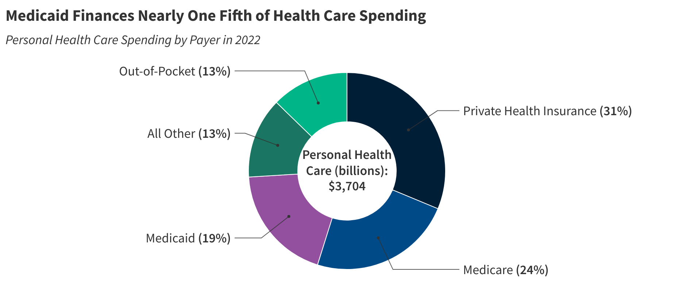
Health care spending broken down by spending
Note: All Other spending includes payments by the Children's Health Insurance Program, the Department of Defense, the Veterans Health Administration, worksite health care, other private revenues, Indian Health Services, workers' compensation, general assistance, maternal and child health, vocational rehabilitation, other federal programs, Substance Abuse and Mental Health Services Administration, other state and local programs, and school health.
Source: KFF estimates based on 2022 National Health Expenditure Accounts data from CMS, Office of the Actuary

Slide 4
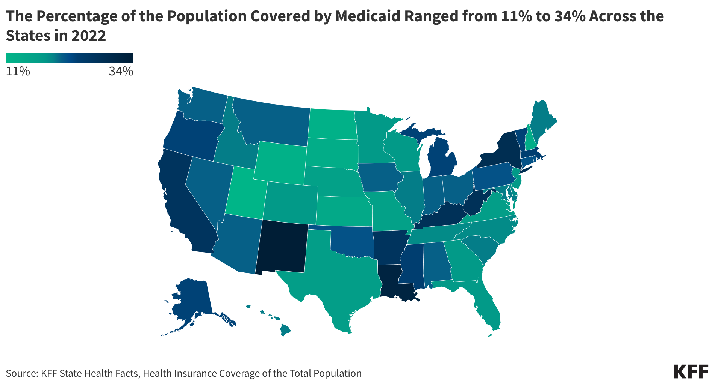
Percentage of Medicaid coverage by state

Slide 5
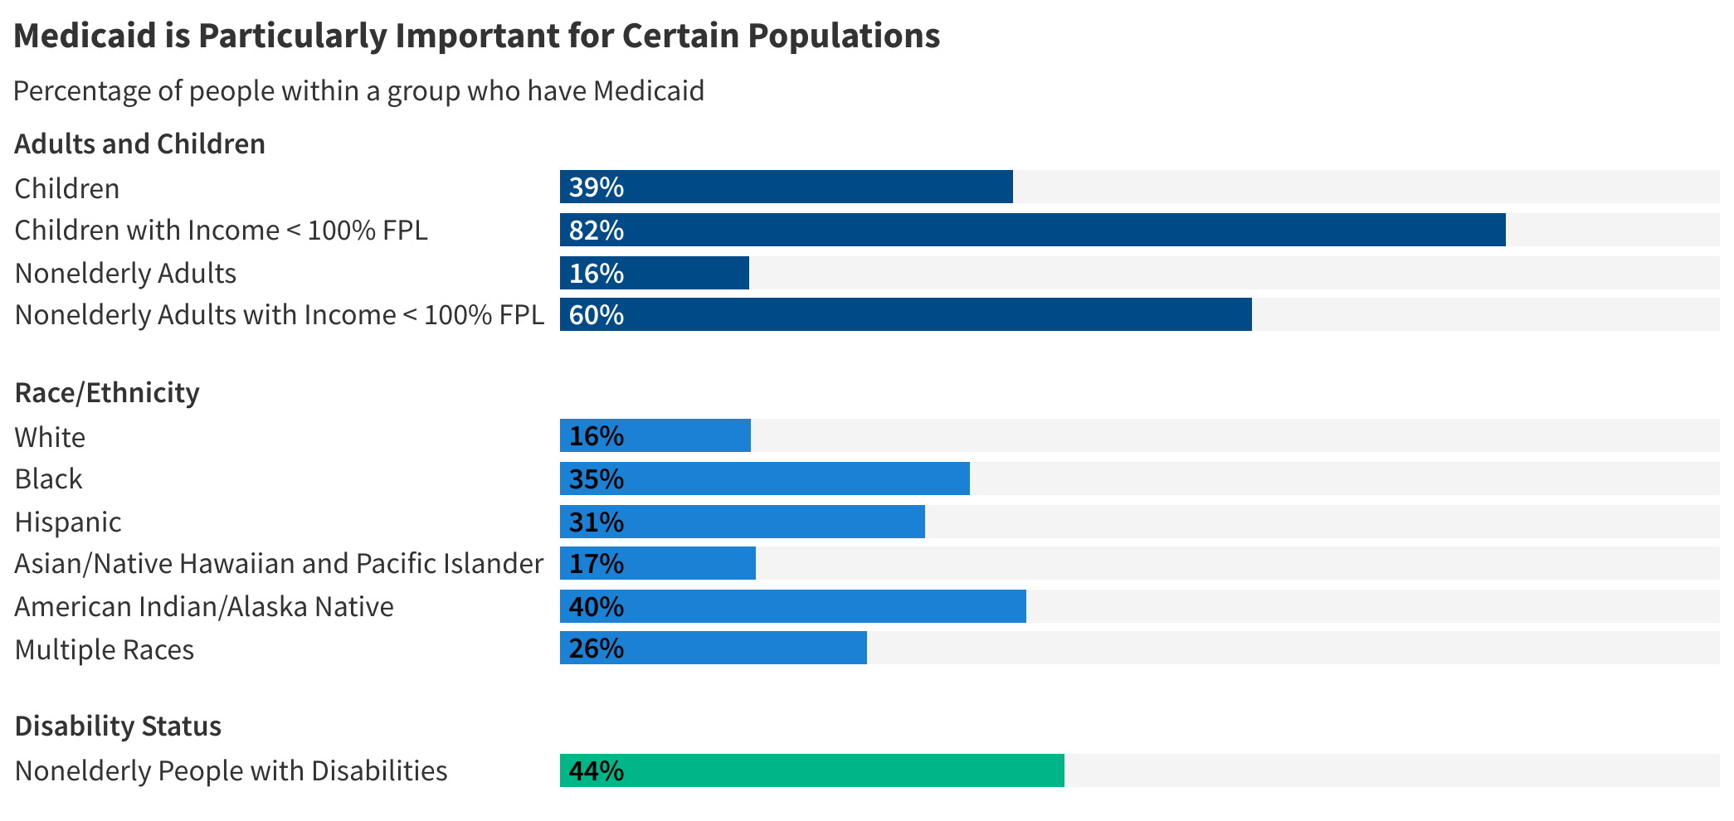
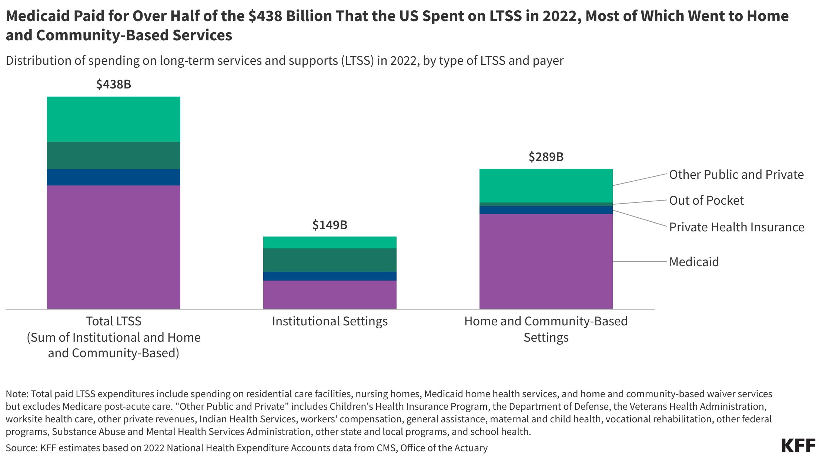
Importance of Medicaid by population
Note: FPL = federal poverty level. Estimates include the civilian, non-institutionalized population. Children includes people ages 0-18, nonelderly adults includes people ages 19-64, nonelderly people includes people 0-64. Disability is defined as having one or more difficulty related to hearing, vision, cognition, ambulation, self-care, or independent living.

Slide 6
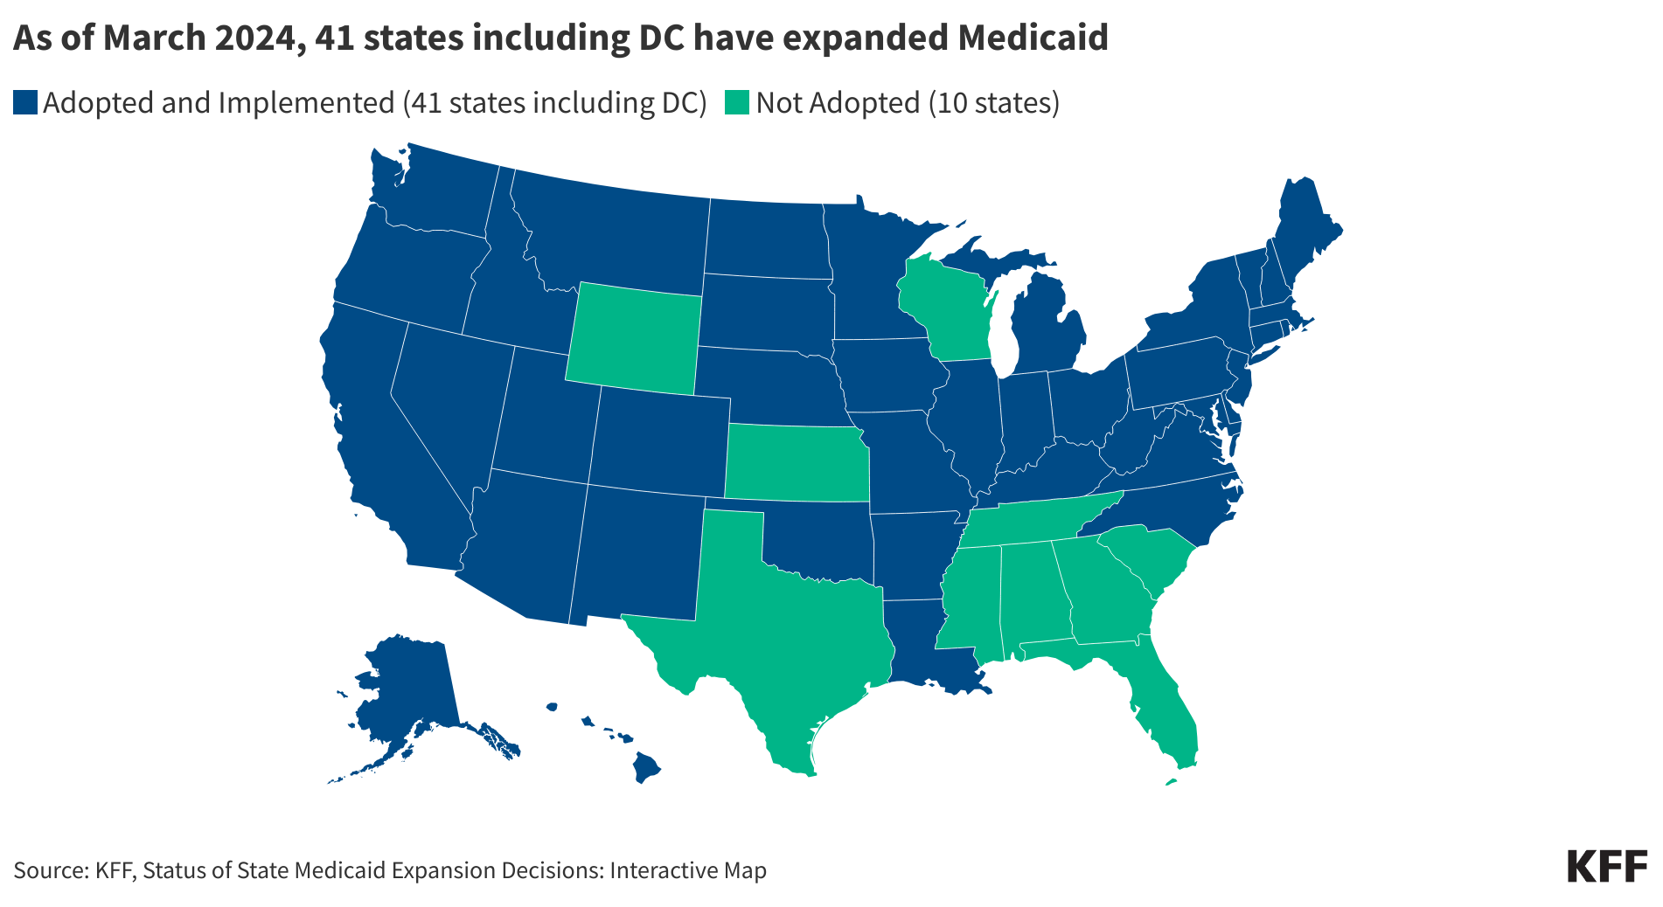
Implementation of Medicaid by state

Slide 7
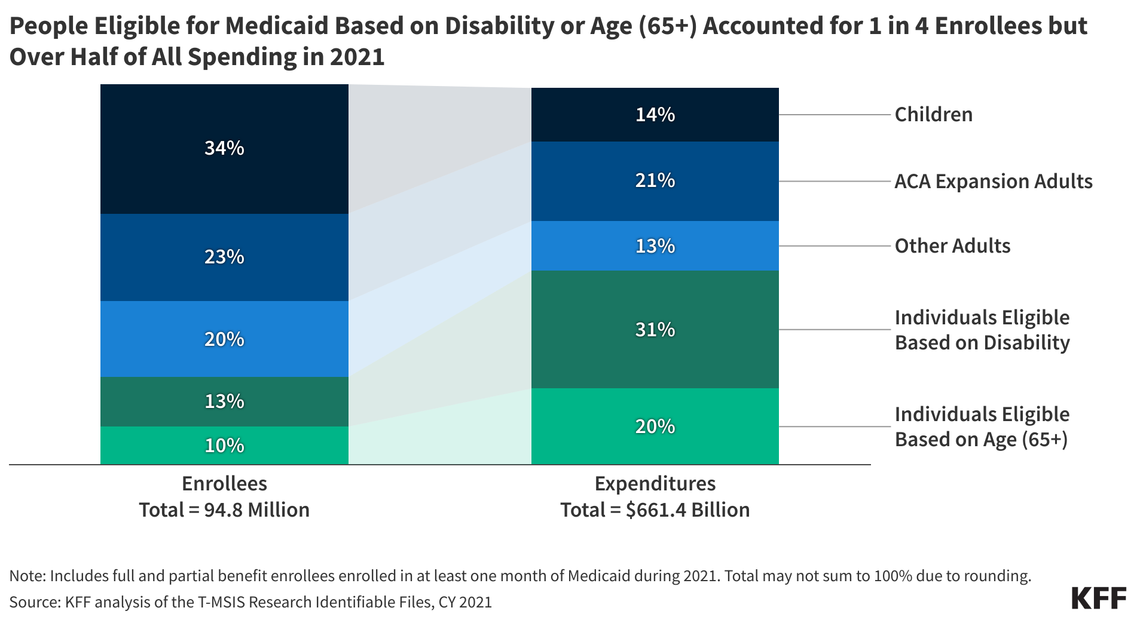
People eligibility of Medicaid based on age

Slide 8
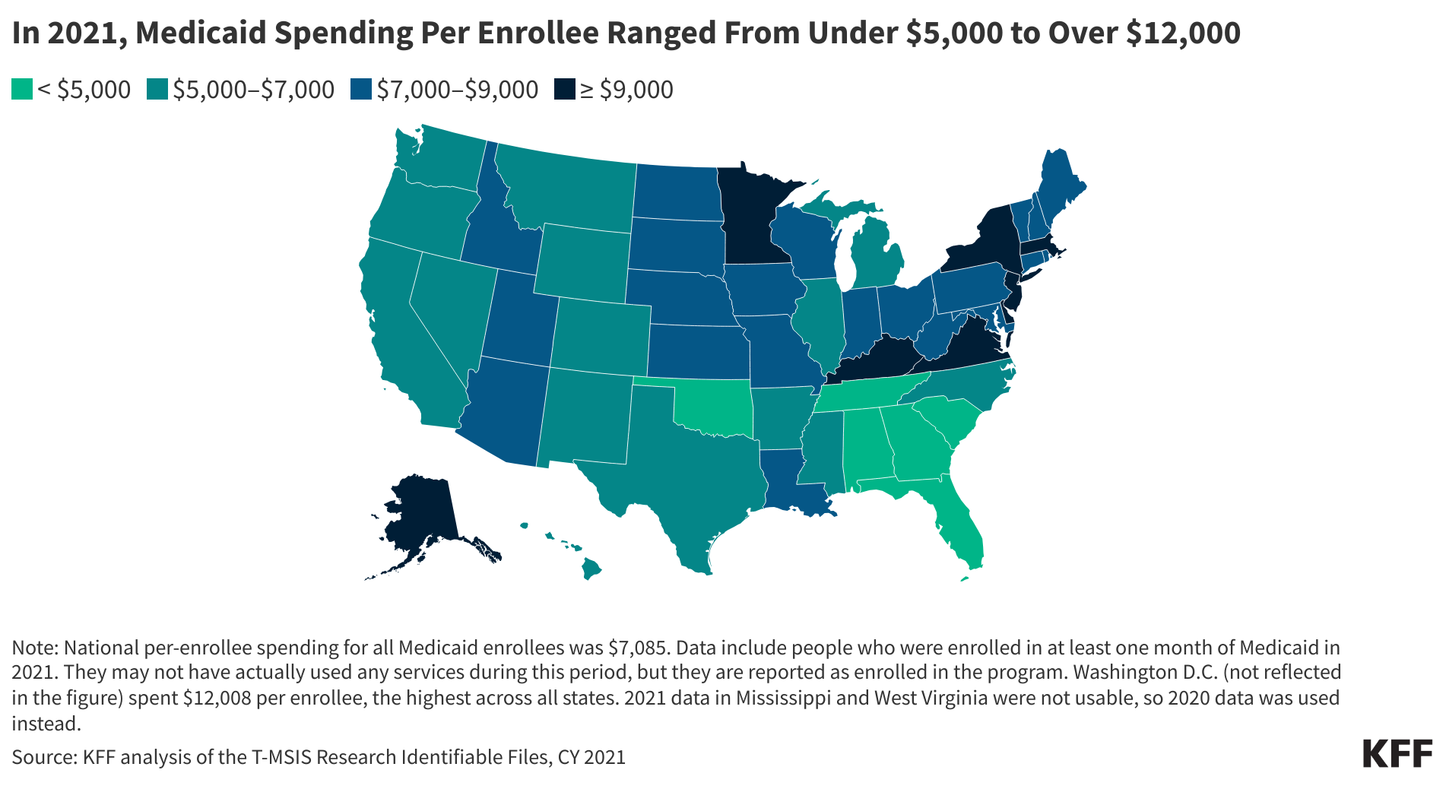
Range of Medicaid spending per state

Slide 9
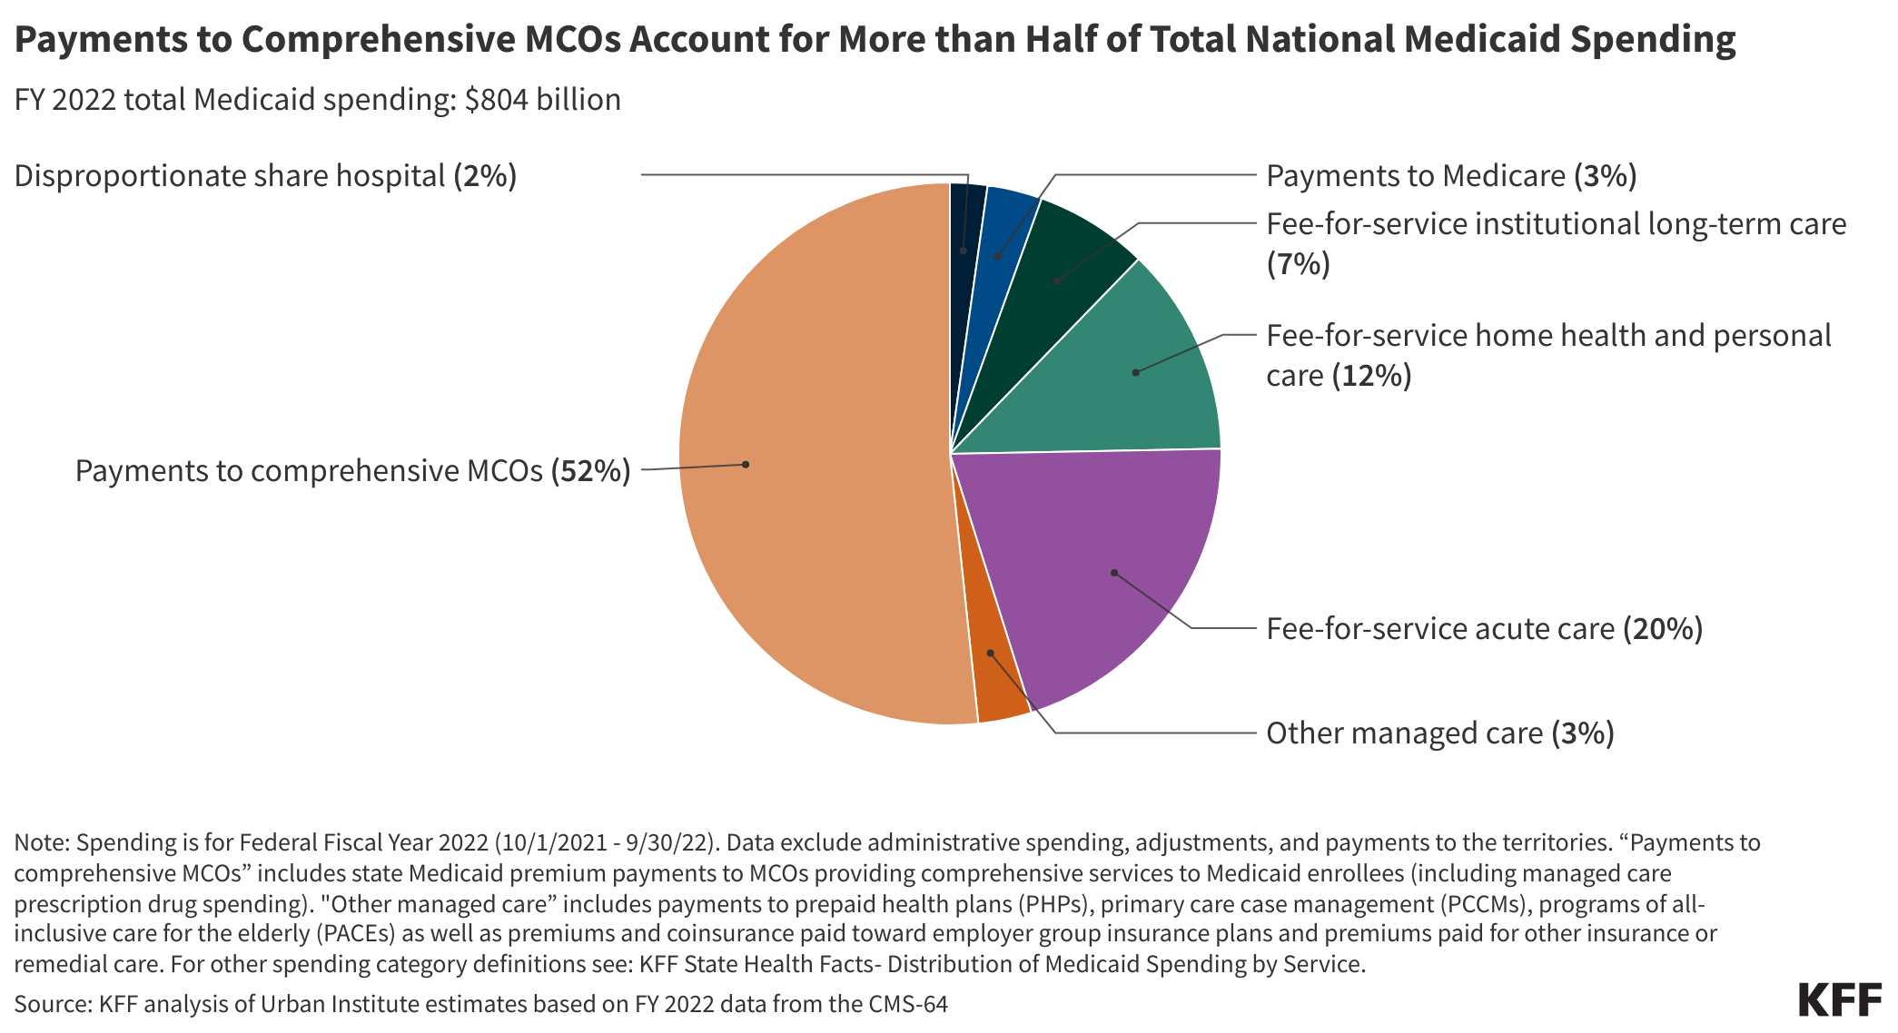
Medicaid payments

Slide 10
Medicaid spending vs other

Slide 11
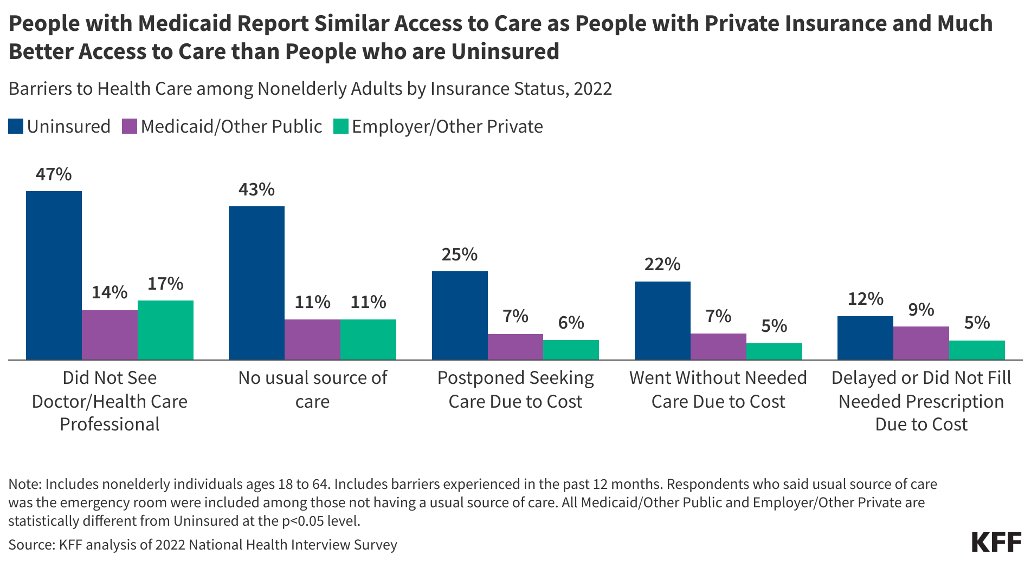
Medicaid access to car vs other access to care

Slide 12
Politics, law, and life generally will determine Medicaid’s future: we have seen this movie before
Republican vision
  Medicaid as welfare to be scaled down through time limits, work requirements, both direct and indirect limits on federal funding (cap on federal spending, new constraints on what counts as state financing
Democratic vision
  Medicaid as insurance to be strengthened through enrollment stabilization reforms, marketplace alignment, continued emphasis on managed care for all populations, stable federal financing but with cost constraints focusing on state financing arrangements
The courts: Medicaid as a privately enforceable legal entitlement under 42 U.S.C. 1983 – Talevski’s progeny

Slide 13
End slide with title card
Notes:
End slide

